Slide 1
Simple Invoice Generation Application
Capstone Project
E Akash

Slide 2
Java Spring Boot Application
First, I use Spring Initializer to create a new Spring Boot project
Language: Java,
Project : Maven,
Spring Boot Version : 3.2.5,
Project name : Invoice Generation Application,
Dependencies : Spring Web, Spring Data JPA, MySQL Driver, Validation, Spring Boot Dev Tools.
Database: MySQL

Slide 3
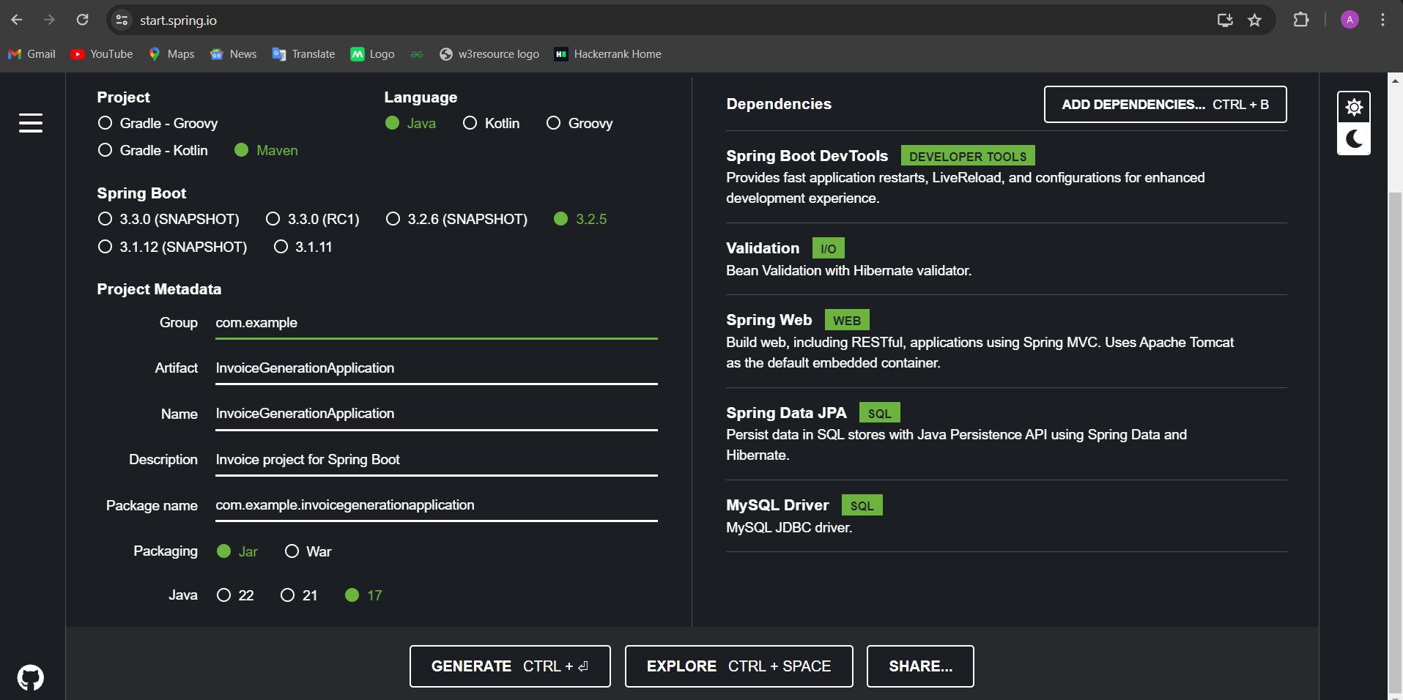
Spring Initializer

Slide 4
Import And Create a package
Next, I have imported this java project(Invoice Generation Application) on Eclipse
After that create a packages.
Controller,
Entity,
DTO,
Exception Handling,
Repository,
Service,
Service Implementation
Controller
I created two controller classes and used them to create 9 REST APIs.

Slide 5
Account Controller
Create account (Post),
Get Login (Get),
Get All account (Get),
Get by id account (Get).
Invoice Controller
Create invoice (Post),
Get All invoice (Get),
Get by id invoice (Get),
Update invoice (Put),
Delete invoice (Delete).

Slide 6
ENTITY
I have created two entity classes from inside the entity package and using one to many and many to one mapping.
Account,
Invoice.
DTO(Data transfer object)
I have created two DTO classes from inside the entity package.
Account DTO,
Invoice DTO.
First one Account and Account DTO table next include the validation for all data.
Id,
User Name,
Email,
Password.
Date

Slide 7
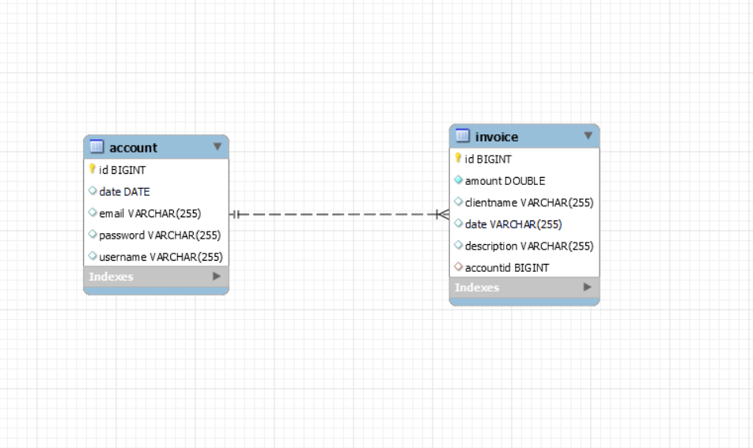
Second one Invoice and Invoice DTO table next include the validation for all data.
Id,
Client Name,
Amount,
Invoice date,
Description,
Account Id

Slide 8
Repository
I have created two repository interfaces using in JPA repository Inside the repository package.
Account repository,
Invoice repository.
And two repository extends on JPA Repository interface.
It specifies the entity type (Account) and the type of the entity's primary key (Integer)
Exception Handling
I have created on global exception handling inside the exception handling package
Any type of error message as goes directly go to the message in controller and handle the error in try and catch block.

Slide 9
Service class
I have created two Interface service classes for inside the service package.
First one Account Service class.
This inside the class I have written four methods
Sing UP(Post)
Sing In(Get)
Get All data for account(Get)
Get By account Id (Get)
Second one Invoice service Class
This inside the class I have written five methods

Slide 10
Create Invoice(Post)
Update Invoice(Put)
Get all data for invoice(Get)
Get by id(Get)
Delete by id invoice(Delete)
Service Implementation class
First one Account Service implementation class and then implement the service interface class.
Implemented methods
Sing up,
Sing In,
Get all,
Get By Id methods

Slide 11
Second one invoice Service implementation class and then implement the invoice service interface class.
Implemented methods
create invoice,
update invoice,
get all invoice,
get by id invoice,
delete by id invoice.
Service is for using business logic. And connect to repository and entity class to save, delete, get all, get by id, update.

Slide 12
Test Cases
I write to test cases for two entity classes and two repository classes.
Account Test and Invoice Test
I write to test cases for getter and setter in two entity classes.
Account Repository Test
I write to test cases for Account repository class
create account,
login success,
login failed,
Incorrect password,
User name and password,
User name and email,
get all,
get by id.

Slide 13
Invoice Repository Test
I write to test cases for Invoice repository class
Create invoice,
Update invoice,
Get All invoice,
Get By Id invoice,
Delete invoice,
Empty invoice.
Application Properties
Application name : Invoice Generation Application,
Server port : 8082,
MySQL database URL : jdbc:mysql://localhost:3306/ your database name,
Database name : invoices,
My database Username and password.

Slide 14
Android Studio
First, I use android studio to create a new android project
Project name : Simple Invoice Generation application,
Activity : Empty view Activity,
Add Dependencies : gson, Retrofit, Coroutines,
Add Network permission: In Android Manifest.xml

Slide 15
Create a Kotlin classes
Retrofit Connection (Object class)
A retrofit connection is a connection to the backend server (http://localhost:8082/)
Account Curd interface
Sign Up (Post) create new account,
Sign In (Get) check user name and password is correct or wrong.
Invoice Curd interface
Create invoice (Post),
Update invoice (Put),
Get All invoice(Get),
Delete invoice(Delete)

Slide 16
Data class for (Account and Invoice)
Account data class
Id,
User Name,
Email,
Password.
Date
Invoice data class
Id,
Client Name,
Amount,
Invoice date,
Description,
Account Id

Slide 17
Main Activity (create account)
Main activity Create an account, account already exits, validation for username, email, password format(one upper case, one lower, case, one number, one symbol and password length minimum 8) and Additional fields include the date of account creation.
Login Activity
Login activity check User Name and password form the backend server like(database) if login success next go to the dashboard automatically and login is failed not going the dashboard and validation for username and password.
Dashboard Activity
I am using on recycler View method and create a list of invoice in dashboard and (Add new invoice, edit invoice, delete invoice) options on available.

Slide 18
New Invoice
Create new invoice (e.g.. Client name, amount, date, description) and validation for client name, amount, date, description. users input the client name(minimum 5 characters), invoice amount (positive and minimum INR 3000), invoice date (past or current date, no future dates allowed), and description are mandatory.
Edit invoice
Users have the option to edit an invoices, allowing modifications to the client name, amount, date, and description and validation for client name, amount, date, description. users input the client name (minimum 5 characters), invoice amount (positive and minimum INR 3000), invoice date (past or current date, no future dates allowed), and description are mandatory.
Delete invoice
Clicking on an invoice in the dashboard navigates the user to a detailed view of the selected invoice. The detailed view presents all relevant information about the invoice, including the client name, amount, date, and description. The application prompts users with a confirmation dialog before allowing them to delete an invoice.

Slide 19
Android Layout Xml files
I have created 7 Activity xml files.
Main activity xml file (Create new Account)
Login activity xml file (Login)
Recycler View Dashboard activity xml file (Dashboard)
Dashboard activity xml file (List of records)
New invoice activity xml file (New Invoice)
Edit invoice activity xml file (Edit Invoice)
Delete invoice activity xml file (Delete Invoice)
And then design all activity xml files.
And download the icons in vector assert (Add, Edit, File, Search, Notification, Share, Reorder, Calendar) icons.

Slide 20
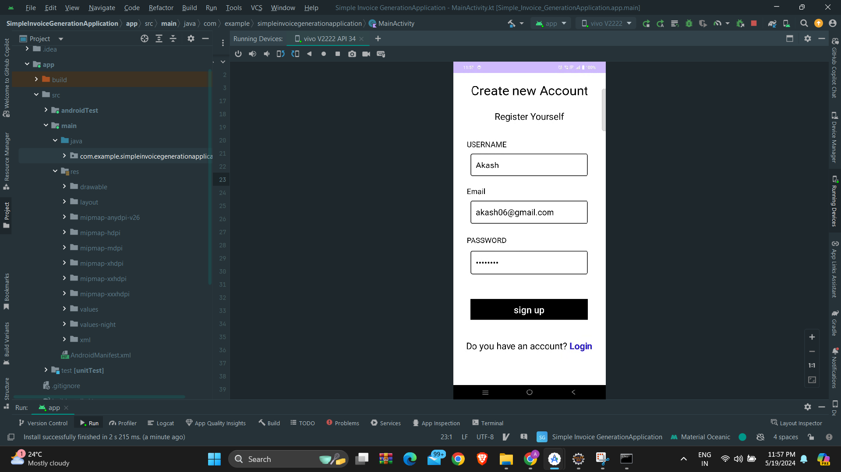
Account Create Output

Slide 21
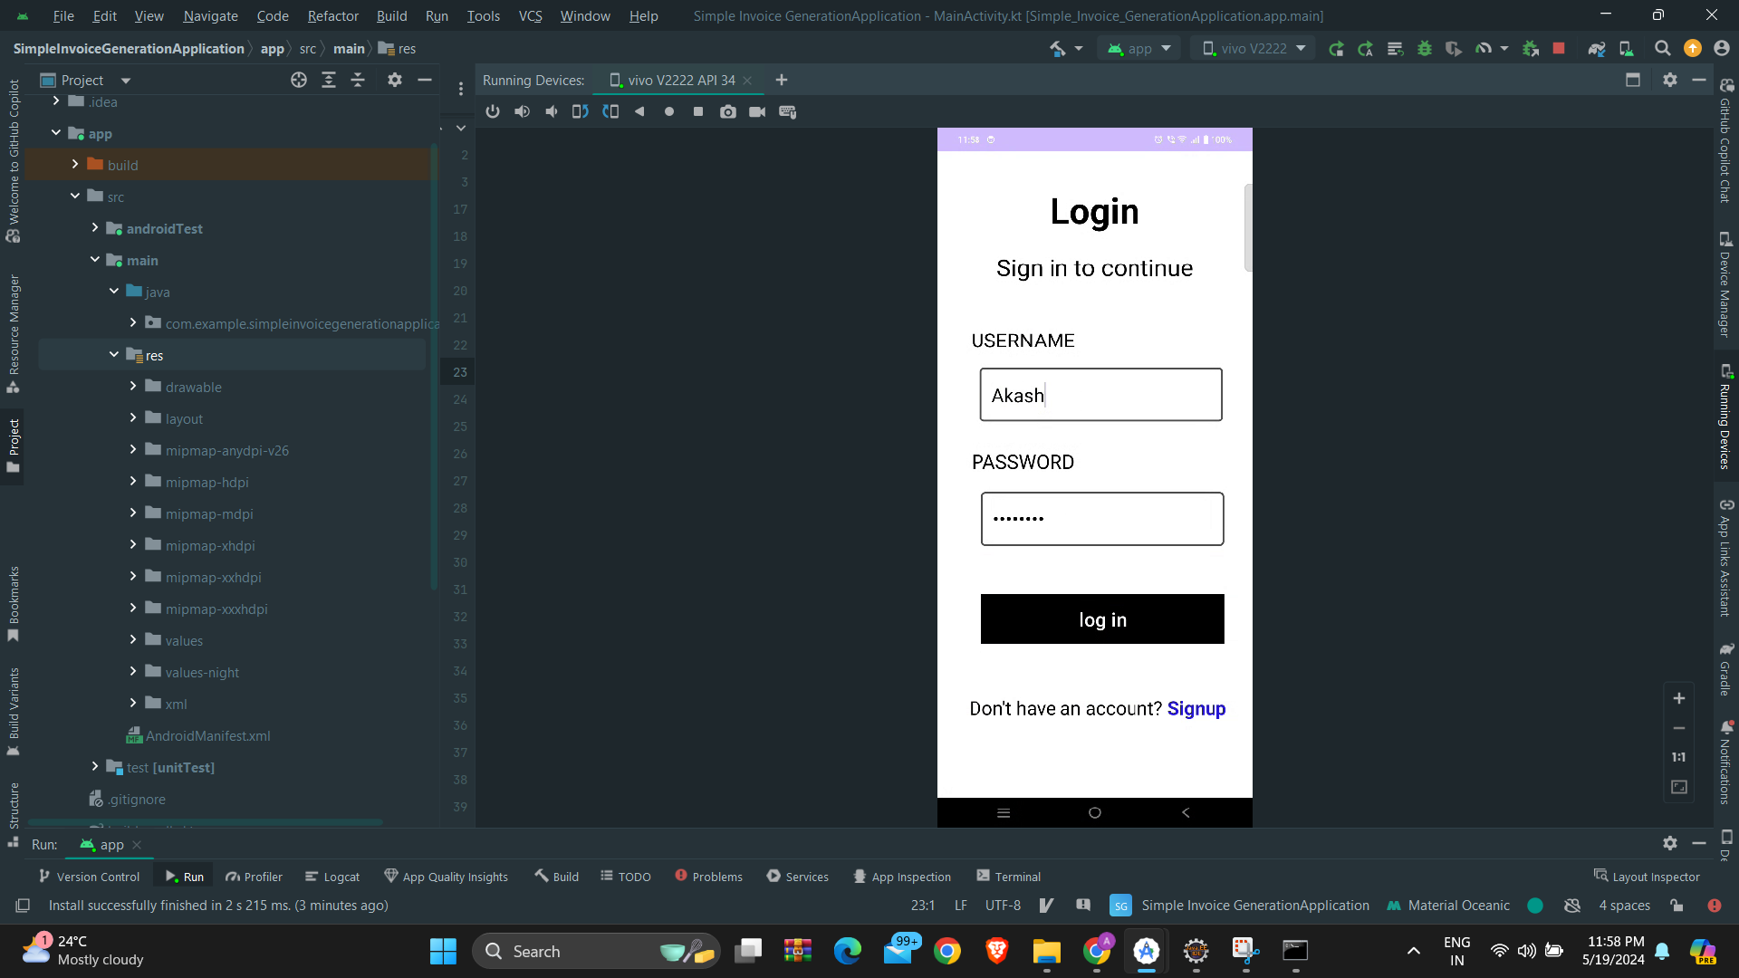
Login Output

Slide 22
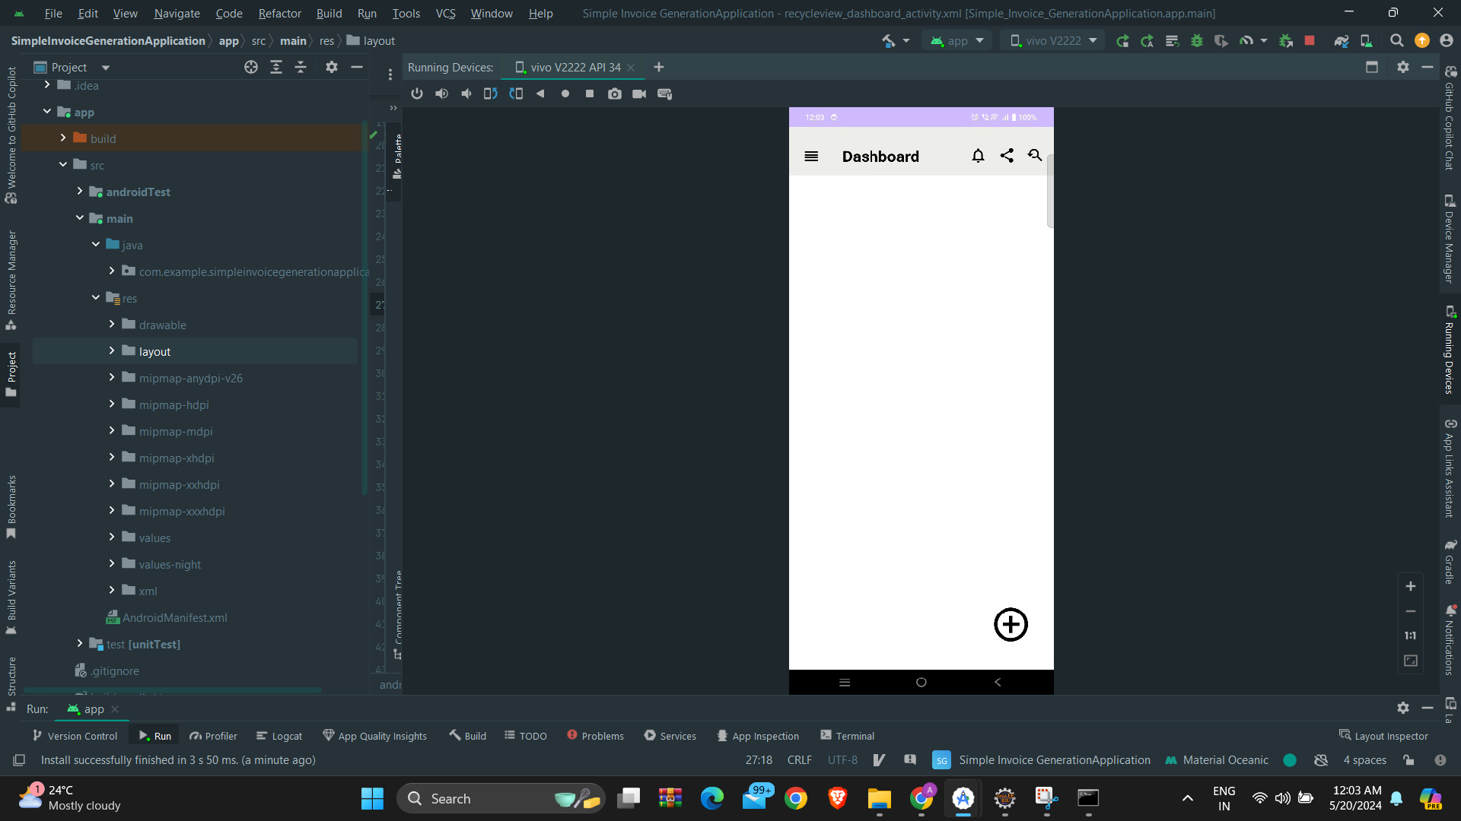
Empty Dashboard Output

Slide 23
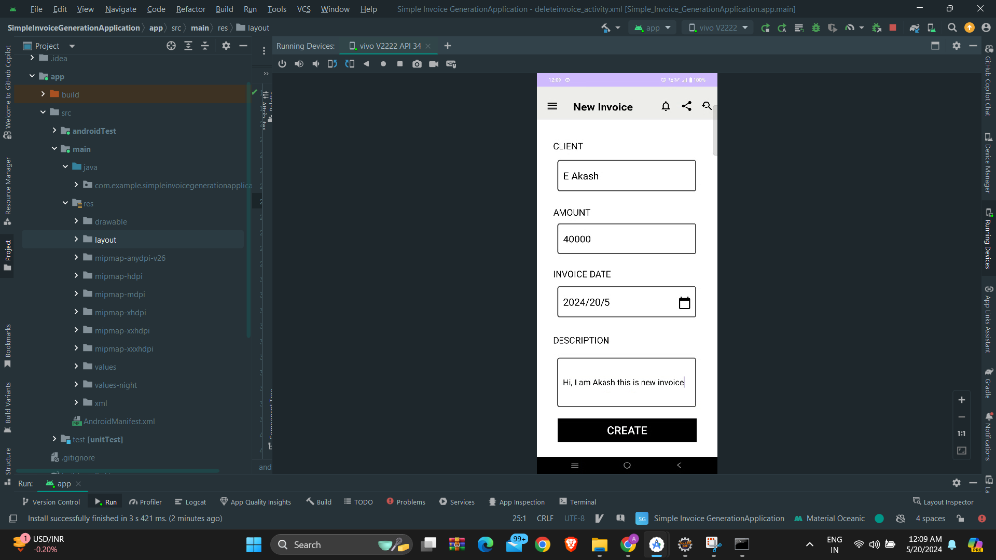
New Invoice Output

Slide 24
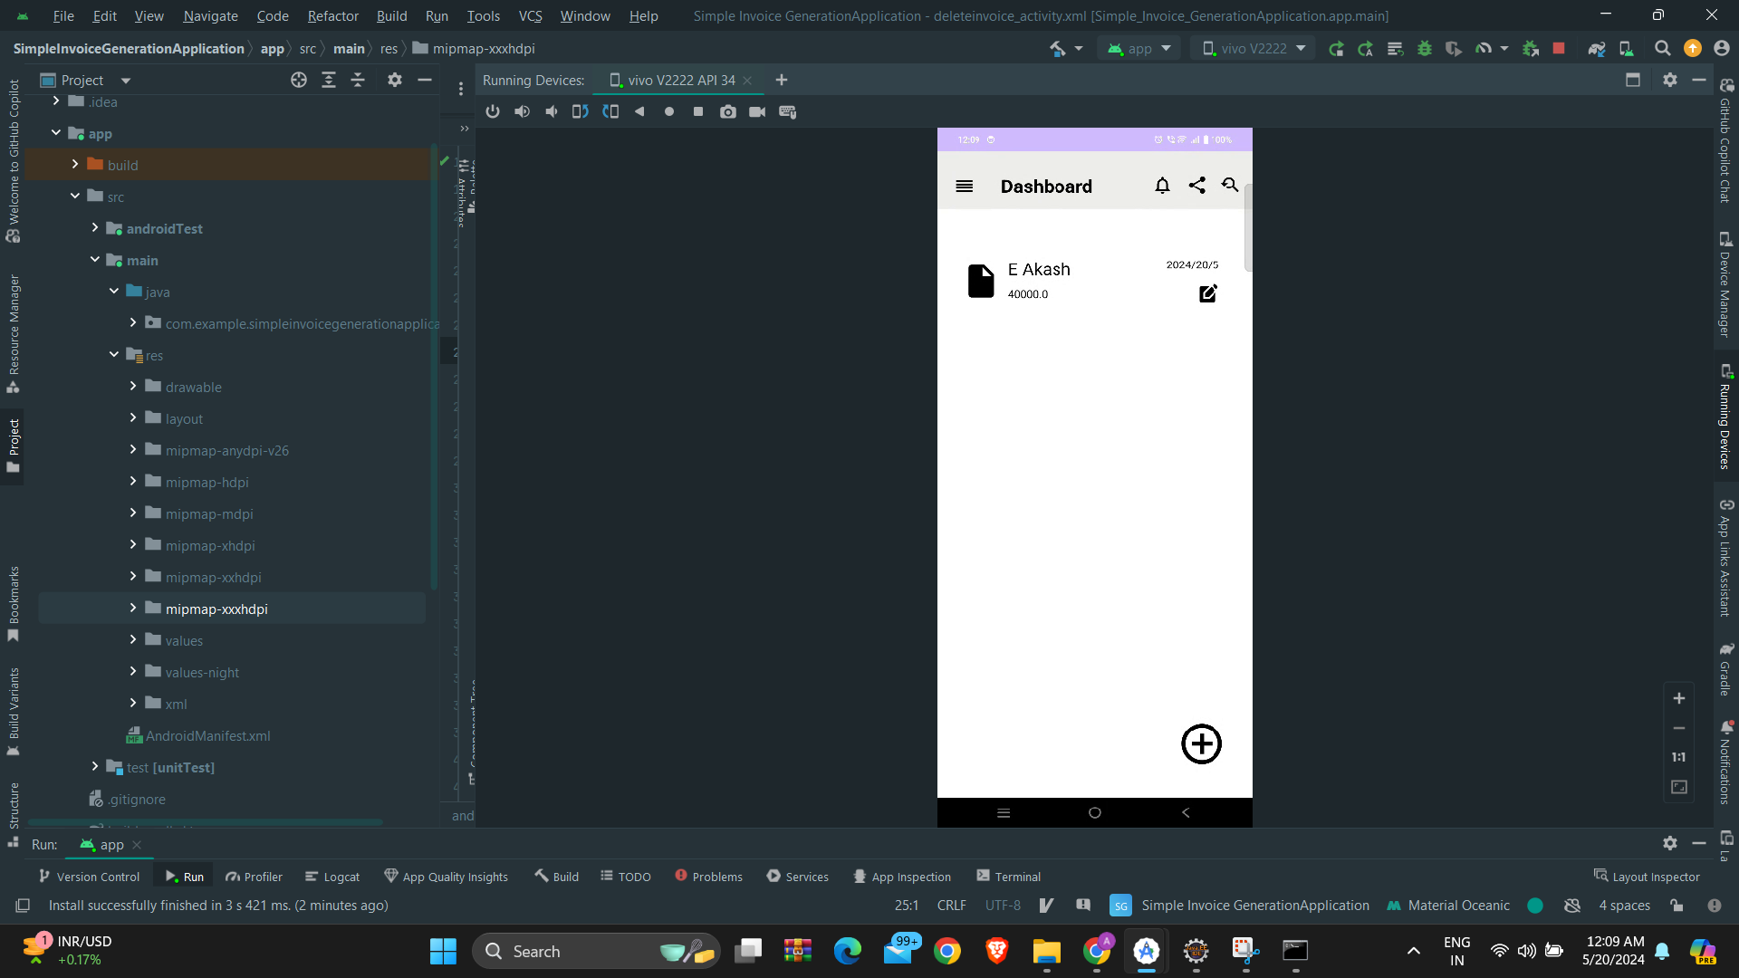
Create Invoice Dashboard Output

Slide 25

Before Edit Invoice Output

Slide 26

After Edit Invoice Output

Slide 27
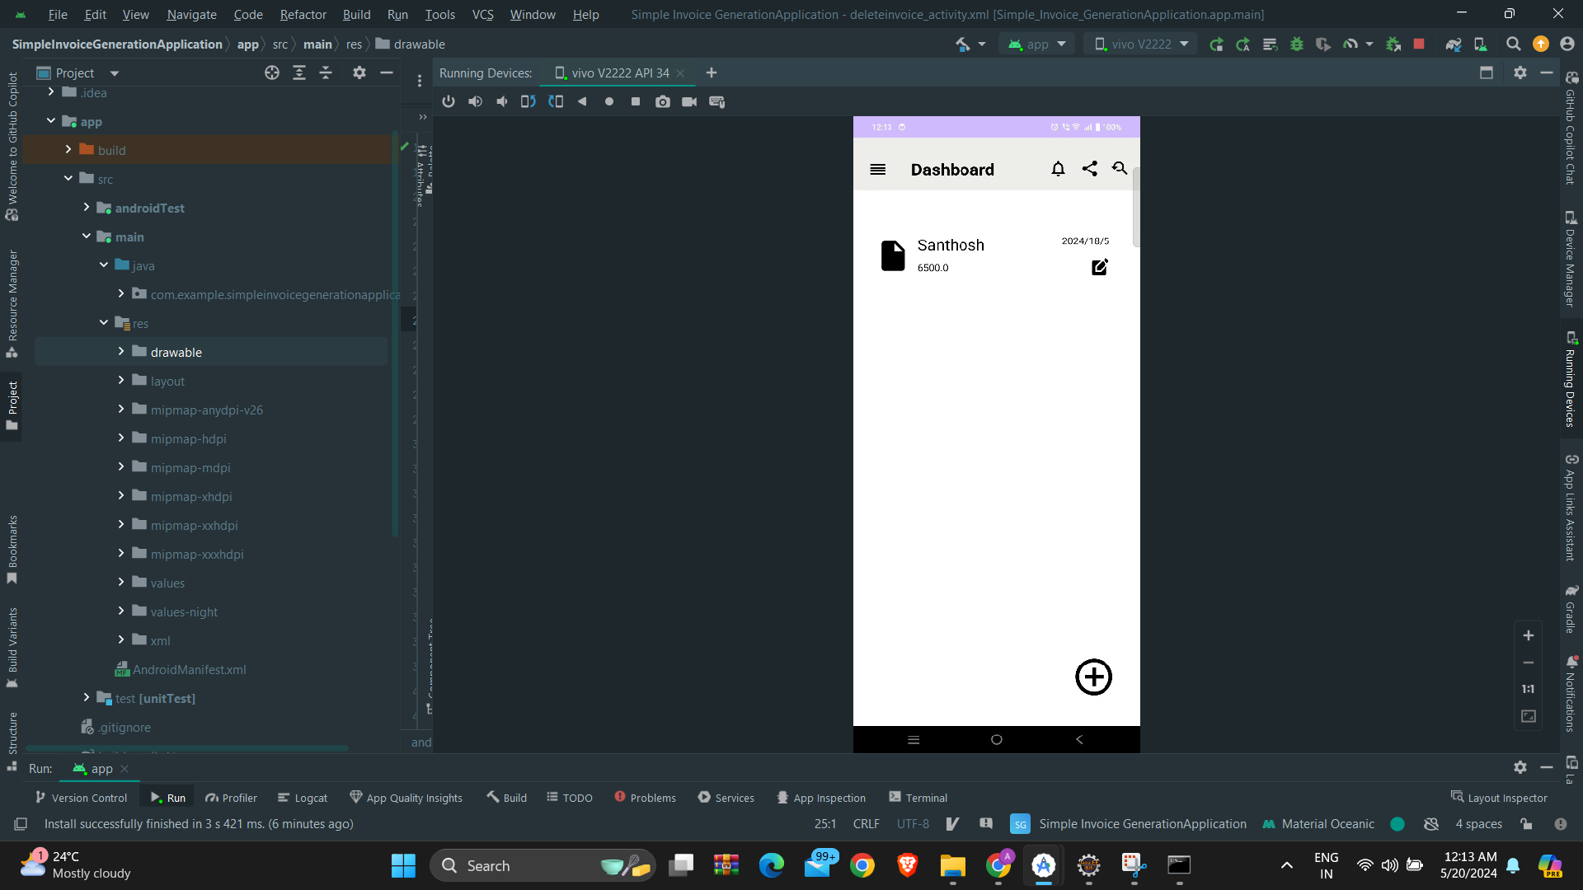
Edit Invoice Dashboard Output

Slide 28

Details Invoice Output

Slide 29
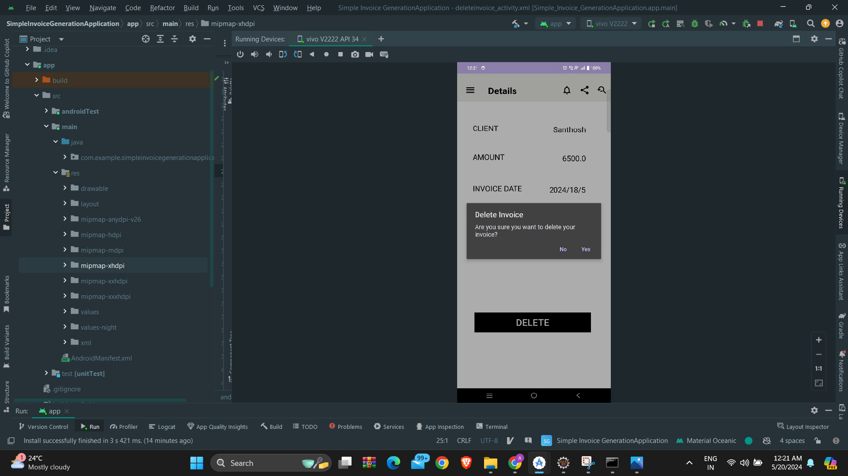
Delete Alert Message Output

Slide 30
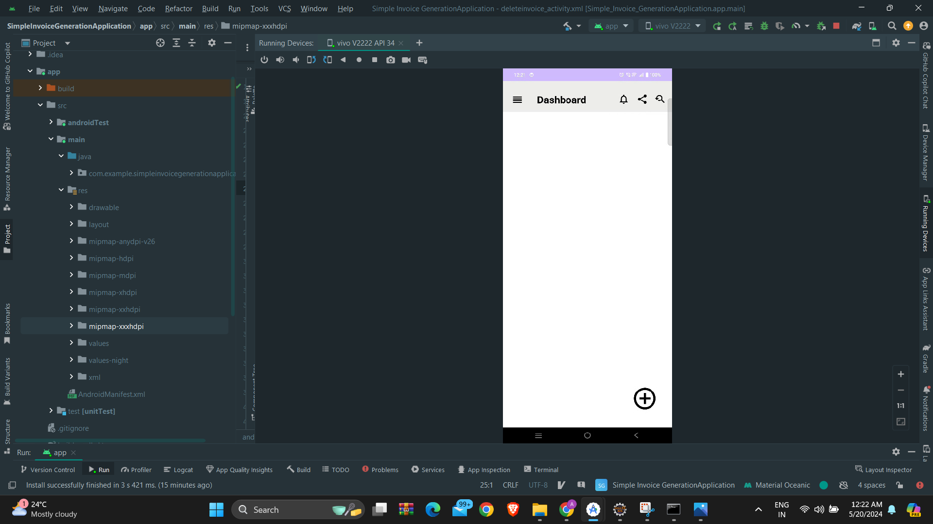
After Delete Invoice Dashboard Output

